Slide 1
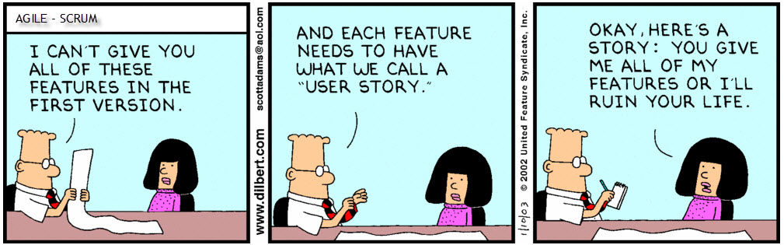
User Stories in an Agile Environment 420-E11 – Systems I Reference: Agile Software Requirements by Dean Leffingwell
Notes:
Ref: http://agileinpills.files.wordpress.com/2013/07/dilbert-userstories.jpg

Slide 2
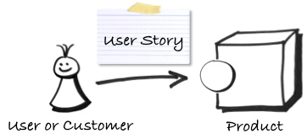
What is a User Story?
A user story is a brief statement of intent that describes something the system needs to do for the user.

Slide 3
Format of a User Story
As a <type of user>, I want <some goal> so that <some reason>
As a customer I want to pay with my credit card, so that I can get my products
As a customer I want to log in with my account so that I don't have to re-enter my personal information every time
Notes:
Type of user: Customer, researcher, etc.
Some goal: Pay with a credit card
Reason: So they can buy groceries

Slide 4
How does a User Story Work?
In a project, progress is demonstrated by delivering tested, integrated code that implements a story.
A story should be understandable to customers, developer-testable, and valuable to the customer.
They should be small enough that the programmers can build half a dozen in an iteration.
Notes:
Ref: Beck and Fowler, 2005
Build half a dozen pieces of functionality for each user stories in each iteration of development

Slide 5
Why?
User stories are a tool for defining a system’s behaviour in a way that is understandable to both the developers and the users. (easy to test)
User stories focus the work on the value defined by the user rather than a functional breakdown structure
User stories provide a lightweight and effective approach to managing requirements for a system.
Notes:
User stories are defined from the user’s perspective

Slide 6
The Six Attributes of a User Story
I Independent
N Negotiable
V Valuable to Users and Customers
E Estimate-able
S Small
T Testable

Slide 7
The Six Attributes of a User Story
Independent
Avoid introducing dependencies between stories
Dependencies lead to prioritization/planning problems
Hard estimate when there are dependencies between stories
Combine dependent stories into one big story
If the combined story becomes too large, find a way to split them

Slide 8
The Six Attributes of a User Story
Negotiable
Stories are not written contracts or requirements that the software must implement.
Story cards are short descriptions of functionality the details of which are to be negotiable
Story cards are reminders to have a conversation rather than fully detailed requirements themselves.
Stories do not need to include all relevant details.
Notes:
They’re used to define what the user expects for the system’s functionality
Nothing is set in stone at this point, it’s just to get a look at what the functionality will look like.
Very high level, little details

Slide 9
The Six Attributes of a User Story
Valuable to Users and Customers
Have the customer write the stories.
Once the customer understands that stories are not a formal commitment to a specific requirement, they become comfortable writing stories themselves
Notes:
The stories need to make sense to the customer. They should write them and they should know it’s not a formal commitment

Slide 10
The Six Attributes of a User Story
Estimate-able
It is important for developers to be able to estimate the size of a story or the amount of time it will take to turn a story into working code.
Why a story may not be estimate-able?
Developers lack domain knowledge : Discuss with customer
Developers lack technical knowledge: Send one or more developers on a spike, which is a brief experiment to learn about an area of the application
The story is too big: Split stories
Notes:
Defining a user story lets developers estimate how long it’ll take and what resources they’ll need to be able to develop that piece of functionality.
If the developers lack the knowledge, they may need some training, part of the resources is having the knowledge.

Slide 11
The Six Attributes of a User Story
Small
Story size matters
If stories are too large or too small you cannot use them in planning.
Epics should be split into smaller stories.
The ultimate determination of whether a story is appropriately sized is based on the team, its capabilities, and the technologies in use.
Notes:
The stories must be small so that they define only one purpose. They’re harder to define if they’re too large.
Epics are multiple stories presented as one, they shouldn’t be there. They need to be broken up into stories

Slide 12
The Six Attributes of a User Story
Testable
Stories must be written so as to be testable.
Successfully passing its tests proves that a story has been successfully developed.
If the story cannot be tested, how can the developers know when they have finished coding?
Notes:
If the story can’t be tested, how do the developers know they’re done?

Slide 13
The Six Attributes of a User Story
I Independent
N Negotiable
V Valuable to Users and Customers
E Estimate-able
S Small
T Testable

Slide 14
3C Guidelines for Writing User Stories
Card
User stories are traditionally written on index cards or sticky notes, in short form.
The main intention is to describe the user story in short form to allow common understanding of the user need among all stakeholders.
Conversation
User stories shift the focus from writing about features to discussing them.
Confirmation
Acceptance tests confirm that the story was delivered correctly.
Notes:
User stories are developed on short little cards to keep them short and simple. They need to be short to allow the developers to be able to estimate things.
Using the stories allows for easy conversation with clients who are requesting the functionality
Makes sure everything works fine.

Slide 15
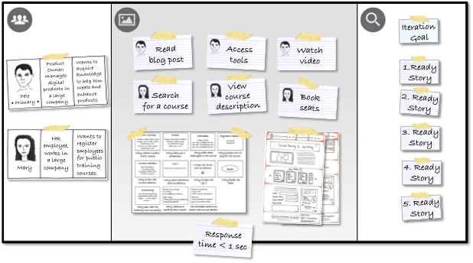
Story Cards – Use Paper Cards or Sticky Notes
Paper cards are cheap and easy to use
Facilitates collaboration, as everyone can take a card and jot down an idea
Cards can also be easily grouped on the table or wall to check for consistency and completeness
Notes:
Used to start a conversation

Slide 16
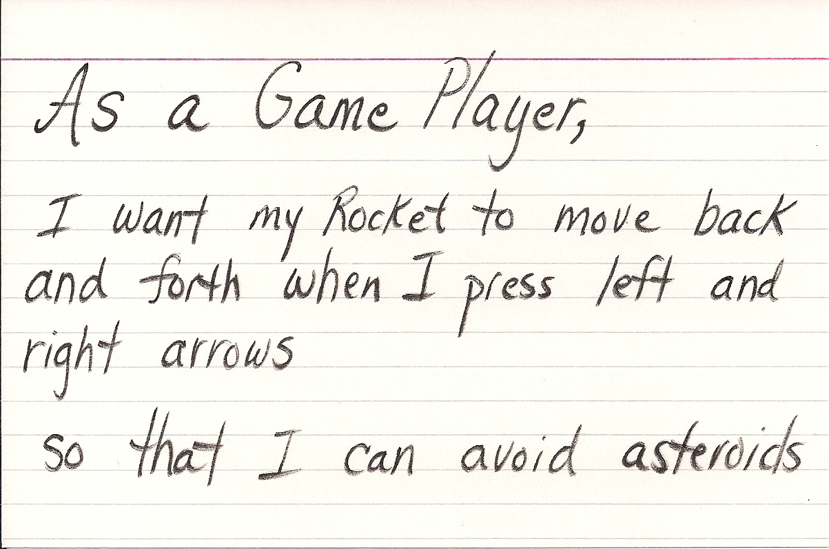
Story Card
Notes:
Ref: http://it-consulting.pl/autoinstalator/wordpress/wp-content/uploads/2013/09/user-story-asteroids.jpg

Slide 17
Epics
Epics are generic, big user stories
Starting with epics allows you to sketch the product functionality without committing to the details
Epics get broken down into features, which get broken down into user stories
Allow you to learn more about the users and how to best meet their needs
Reduces the time and effort required to integrate new insights
Notes:
They’re higher level, bigger picture of how all the user stories relate to each other.
They give you a big starting point for what you’re doing. Gives you an idea of how the end product acts
An epic gets broken down into different features and functionalities

Slide 18
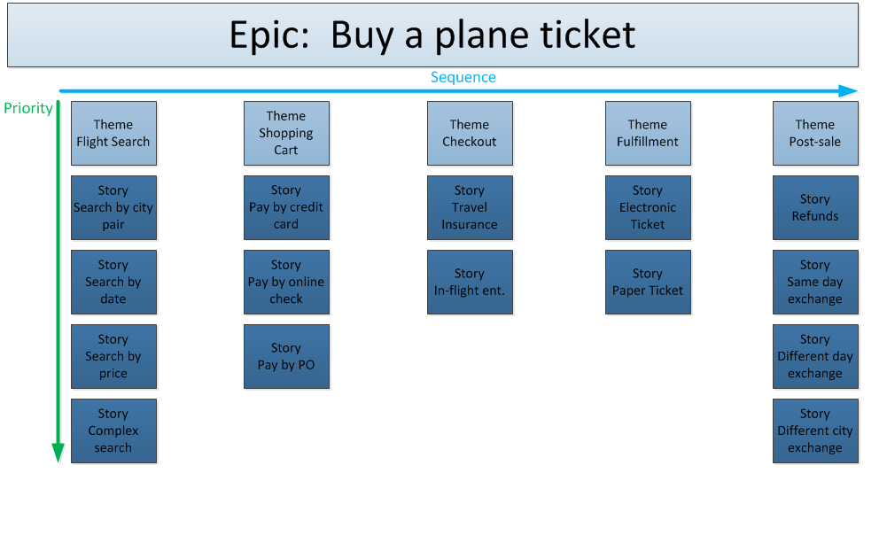
Notes:
Epics also have themes, for the buy a plane ticket example above, you have a theme to search for the flight, one to move a ticket to the shopping cart, one for the checkout, one for fulfillment and finally anything that has to happen post sale. For each theme you then have multiple stories.

Slide 19
Themes
Group user stories into themes
Using themes helps you organise your stories.
Sample themes for a mobile phone are email, calendar, voice communication, and organizer
Facilitate prioritization
Notes:
Themes help you organize things. Each epic has themes, each theme has stories and each feature is a story.

Slide 20
Business Rules Integration to User Stories
A User Story
As a doctor I want to add patient information in order to create a new patient file
A Business Rule
The following information must be entered in the record of each patient: (a) patient: (i) name and given name; (ii) address; (iii) date of birth; and (iv) sex
Notes:
The business rule is a very specific version of the user story. It’s the low level rules version of it. The stuff that becomes set in stone. Each user story is defined by business rules. Used to clarify requirements

Slide 21
Acceptance Criteria
Defines the boundaries of a user story
Are used to confirm when the software is working as intended
Are essential to defining the completion of a story.
Notes:
They define when the story is done.

Slide 22
Acceptance Criteria
Good acceptance criteria should include:
Usability: Indicate how to answer the question: Is it easy to use? The key is to identify the right measurements and make sure each is quantifiable.
Functionality: Identify specific user tasks, business processes, or functions that must be in place at the end of the project. For example: The user can choose from multiple sizes.
Error handling: Enumerate error cases and how each should be handled. For example, if a user performs the steps in the wrong order, how will the software handle it?
Performance: Test system performance from the perspective of an individual user. For example: Is the UI responsive?
Stress tests: Describe how the system responds when it is under stress because there are many users, transactions, or queries.
Notes:
http://wiki.servicenow.com/index.php?title=Well-Written_Scrum_Stories#gsc.tab=0
The acceptance criteria is what defines whether or not you have working user stories. Lets the developer know they’ve coded the user story correctly

Slide 23
Example of Good Acceptance Criteria
Description: As a customer, I want to order and pay for the book via a secure web-based form, so that my credit card information is safe.
Acceptance Criteria:
All mandatory fields must be completed before a customer can submit a form.
Information from the form is stored in the customer orders database.
Payment can be made via Amex, Master Card, or Visa credit card.
The system shall accurately calculate and apply sales tax.
The system shall accurately calculate and apply shipping charges.
The customer shall be able to verify the accuracy of the order.
An acknowledgment email is sent to the customer submitting the form.
Protection against spam is working.
Notes:
http://wiki.servicenow.com/index.php?title=Well-Written_Scrum_Stories#gsc.tab=0

Slide 24
Example of Bad Acceptance Criteria
Description: As a customer, I want to receive notifications when an incident is commented, so that I am updated on the status.
Acceptance Criteria: The appropriate people are notified when incidents are commented.
The acceptance criteria are poor because they do not give enough detail to test; for example, it's not clear who the appropriate people are.
The acceptance criteria could be better written as:
As an ESS user, create an incident.
Select Notify interested parties.
Save the incident.
Log in as an interested party.
Check that you have received an email for the logged incident.
Would have multiple acceptance criteria, for every different user type.
Notes:
http://wiki.servicenow.com/index.php?title=Well-Written_Scrum_Stories#gsc.tab=0

Slide 25
What, not How
Avoid ‘The how trap’
Acceptance Criteria should state intent, but not a solution
e.g. “A user can approve or reject an invoice” rather than “A user can click a checkbox to approve an invoice”.
The criteria should be independent of the implementation, and discuss WHAT is expected, and not HOW the functionality will be implemented.
Notes:
http://www.leadingagile.com/2014/09/acceptance-criteria
Not defining how to do things, you’re not coming up with a solution, you just want to know what the user wants.

Slide 26
Summary
User Stories combine written and verbal communications
User Stories should describe features that are of value to the user
Written in the user’s language
User Stories detail just enough information and no more
Details are deferred and captured through collaboration just in time for development
Test cases should be written before development, when the User Story is written
INVEST - User Stories should be Independent, Negotiable, Valuable, Estimate-able, Small and Testable
Notes:
Test cases are written along with the user stories and acceptance criteria

